Slide 1

Microsoft_Studio_Project Research Analysis
Author; Kimani Njambi

Slide 2

Summary
Based on the Analysis with the help of Python software;Several patterns emerged regarding the Movie production sector.
The market has domineering studios from whom Microsoft would take learnings like Disney, Fox and Universal.
As a new entrant, there would be need to; focus on underserved film genres to build market presence.
Focus on genres that cover across cultural contexts,as seen in the oversees revenues surpassing the domestic revenues.

Slide 3
Business Problem
Microsoft lacks the knowledge of the movie production sector despite the desire to venture into the market.
Microsoft is a total newbie and wishes to understand which genres are most profitable and preferred, and also the studios to emulate and learn from

Slide 4



Data
Provided zipped datafiles from Box Office Mojo dataset were ;
bom.movie_gross
imdb.title.basics
imdb.title.ratings
With the title columns as;
Index(['title', 'studio', 'domestic_gross', 'foreign_gross', 'year'], dtype='object') Index(['tconst', 'primary_title', 'original_title', 'start_year', 'runtime_minutes', 'genres'], dtype='object’)
Index(['tconst', 'averagerating', 'numvotes'], dtype='object')

Slide 5

Methods
Data cleaning and preparation-> Handling multi-genre fims, Removing irrelevant entries like ‘Unkown’, Data Aggregation using .groupby().
Descriptive Statistics -> Mean and Sum calculations of eg avg gross revenue, avg ratings per genre, Sorting and ranking using .sort_values() to identify top studios, genres.
Comparative Analysis;-> Domestic vs Foreign revenue comparison, studio revenue comparison.
Visual Analysis(Data Visualizations -> Using bar charts, Boxplots(distribution), Histograms(distribution), Heatmap(correlations), scatter plot(relationship)
Correlation and Relationship Analysis -> Correlation matrix .corr() and sns.heatmap() to identify strengths and direction of relationships.

Slide 6
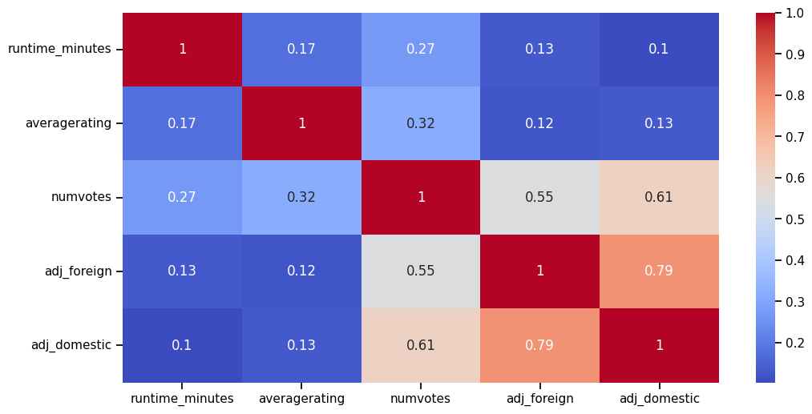
Results
Strong positive correlation; [0.79], Movies that perform well in the domestic market also tend to perform well in the foreign market, and vice-versa.
Runtime and total gross showed a weak correlation; hence runtime is far from a decisive factor in financial performance.
A strong correlation in domestic and foreign revenue reveals a mirror effect in success of a movie.
Sci‑Fi, Adventure, and Animation emerge as the most lucrative categories in both domestic and foreign markets.
Top tier studios like Buena/Disney, Fox, Universal, Warner Bros, Sony, Paramount are the to- go -to kind of studios for knowledge acquisition.

Slide 7

Conclusions
Microsoft should ;
Leverage on blockbuster genres (Sci-Fi, Adventure, Animation) for both domestic and global success.
Maintain strong franchise development and invest heavily in marketing to sustain audience engagement.
Compete in niche markets by producing high-quality content in genres underserved by major studios, such as Documentary, Biography, or History, and leverage streaming platforms to expand reach.
Global Strategy: Prioritize content with universal themes, star power, and visual appeal for international markets.
Consider multilingual releases and culturally adaptive marketing to maximize foreign revenue.
Audience Engagement: Build and maintain fan communities for high-engagement genres like Sci-Fi and Action.
Harness social media, exclusive fan events, and interactive campaigns to boost voting and ratings participation.
Risk Mitigation: Since ratings don’t strongly predict revenue, Microsoft should focus on strategic market placement, optimal release windows, and marketing campaigns rather than relying solely on critical acclaim.

Slide 8
Limitations;
-Data Gaps: Missing or incomplete data on revenues, and genres attributes may limit the accuracy of conclusions.
Historical Bias: The analysis relies on historical data, which may not account for shifting audience preferences , emerging genres or adjusted revenues due to inflation .
Multilabel Genres: Movies belonging to multiple genres could dilute the financial and audience impact attributed to a specific genre.

Slide 9
Pointers to Improvement;
Enhanced Data Quality: Filled in missing data, standardized formats across sources, and adjustment for inflation to ensure more accurate comparisons.
Incorporation of Marketing Metrics: Inclusion of data on advertising budgets, promotional strategies, and audience engagement to provide a more holistic view of a movie's success.
Exploration of Streaming Impact: With the rise of streaming platforms.There would be need to consider how simultaneous theatrical and online releases affect profitability.

Slide 10
Thank You!
Email: kimani.jacque@outlook.com
GitHub: @ kimanijacque LinkedIn: https://www.linkedin.com/in/jackline-kimani-39642597/

